Slide 1
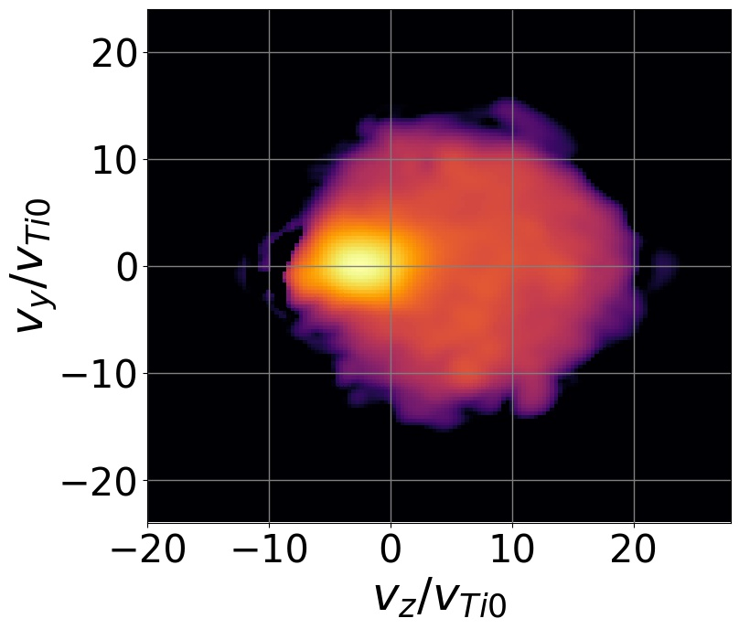
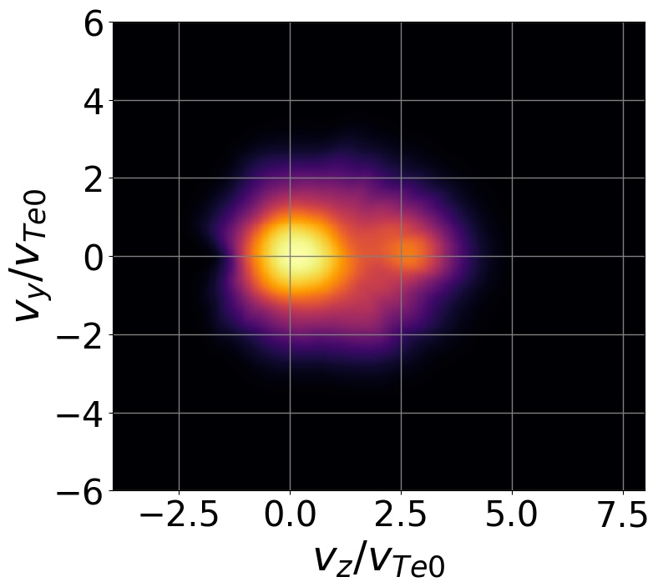
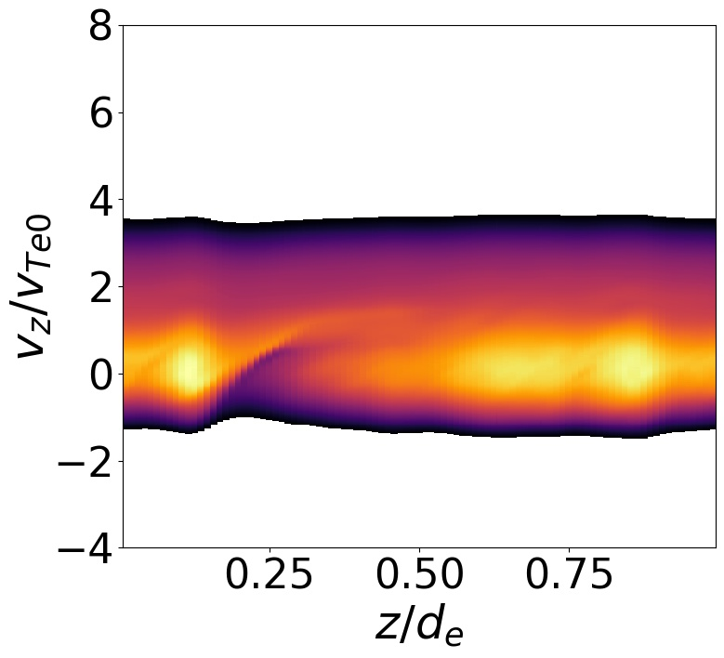
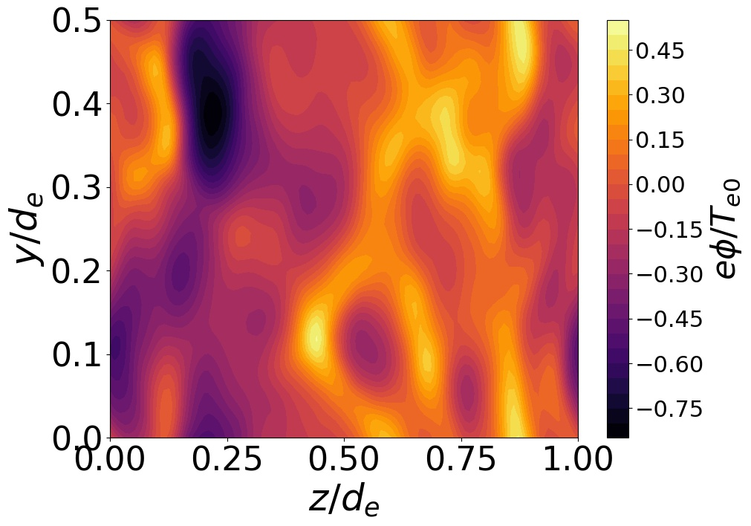
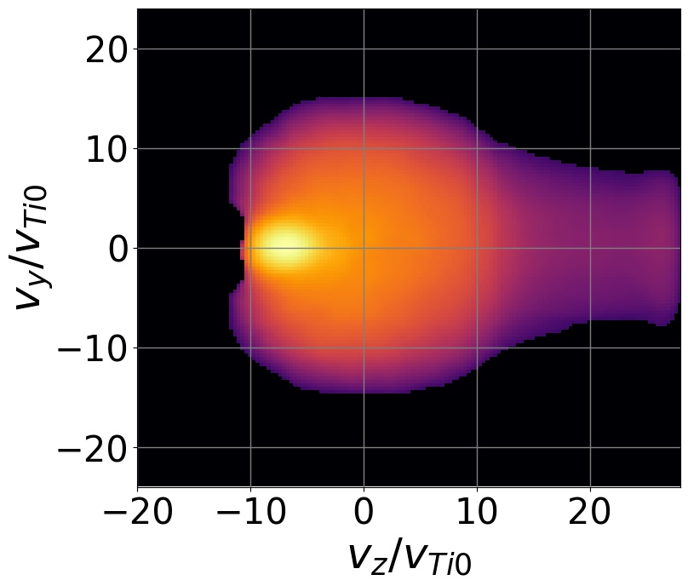
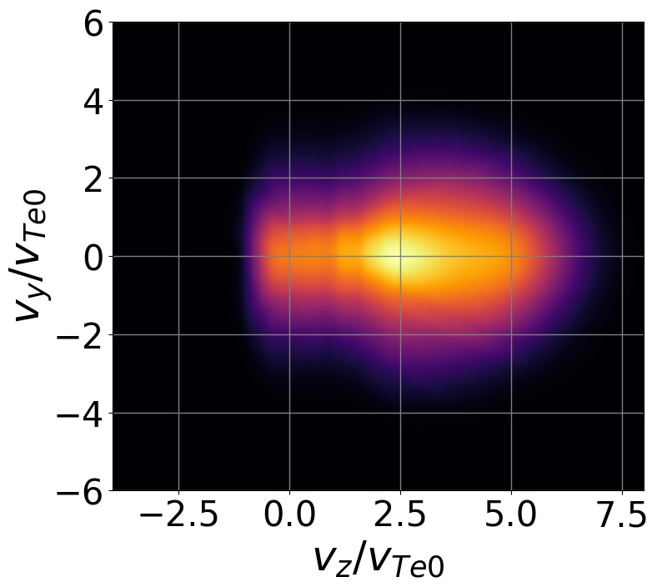
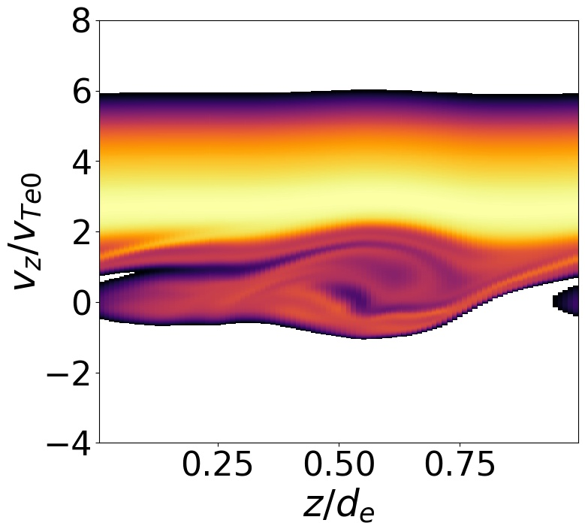
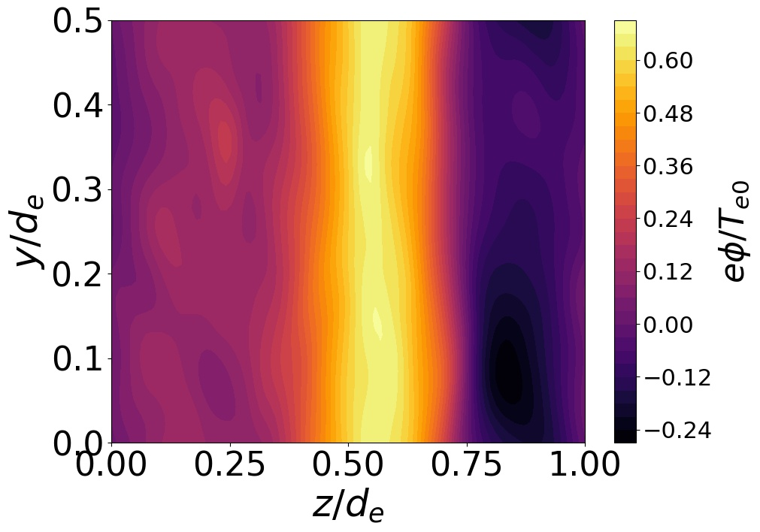
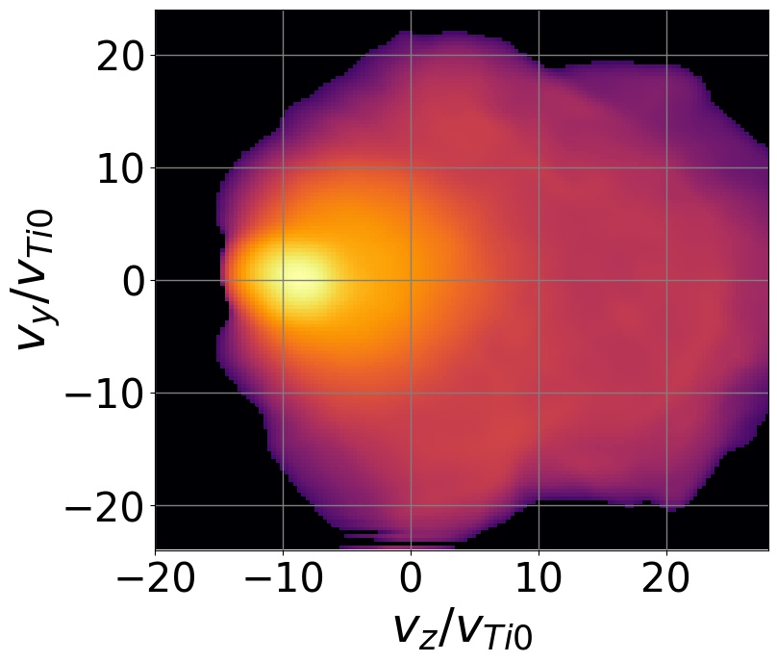
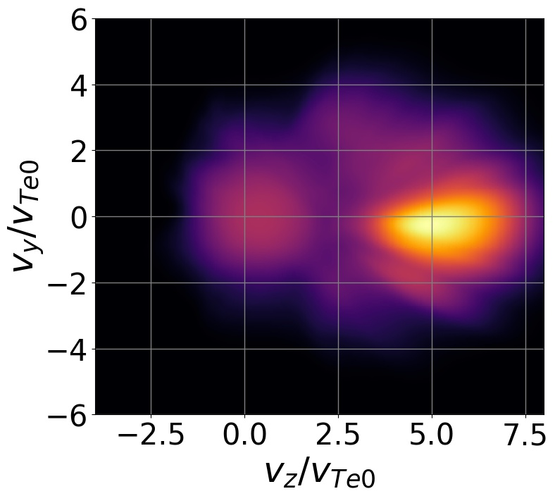
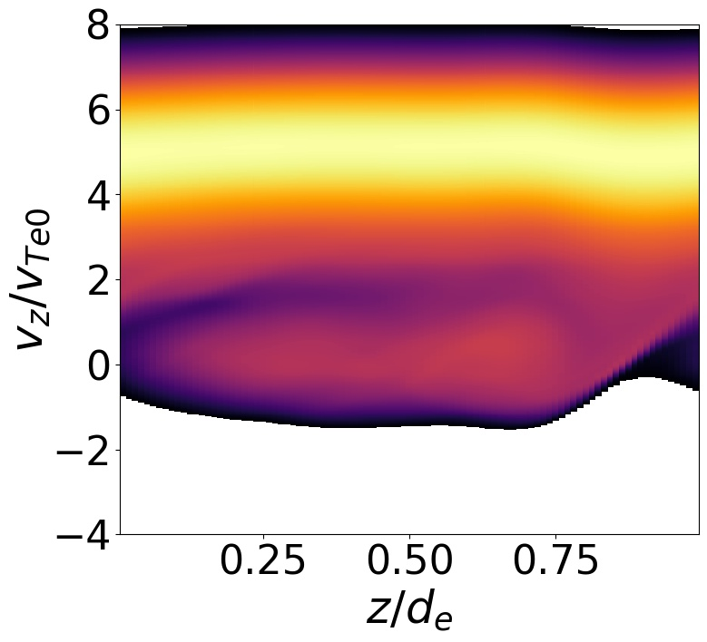
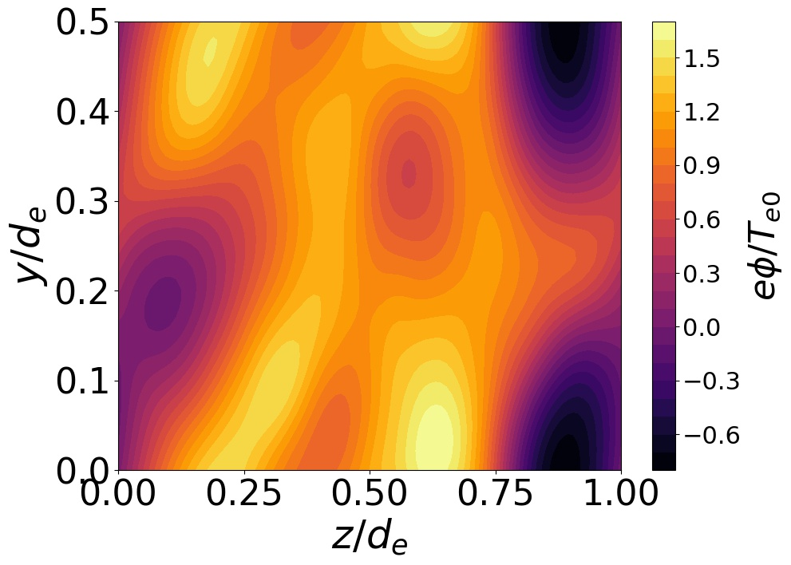



${log (F}_{i}\left(v_{z},v_{y}\right))$ $F_{e}\left(v_{z},v_{y}\right)$ $F_{e}\left(z,v_{z}\right)$ $φ(z,y)$
$$ω_{pe}t =750$$
$$ω_{pe}t = 1800$$
$$ω_{pe}t =2400$$

Slide 2


${log (F}_{i}\left(v_{z},v_{y}\right))$ $F_{e}\left(v_{z},v_{y}\right)$ $F_{e}\left(z,v_{z}\right)$ $φ(z,y)$
$$ω_{pe}t =750$$
$$ω_{pe}t = 1800$$

Slide 3
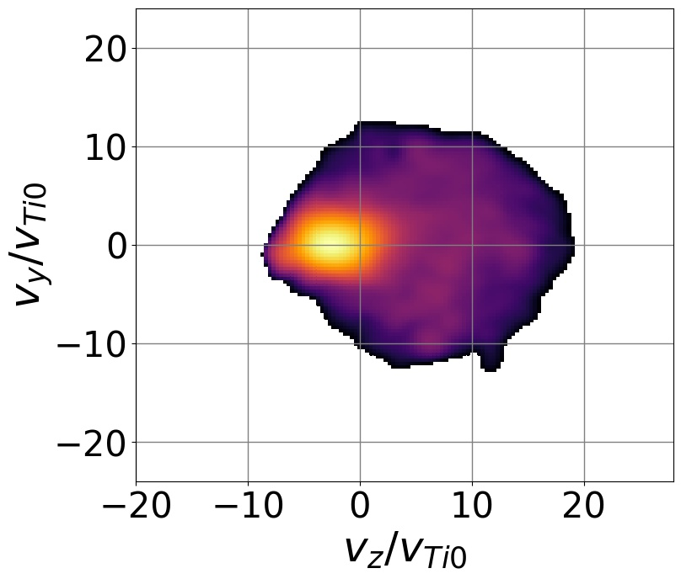
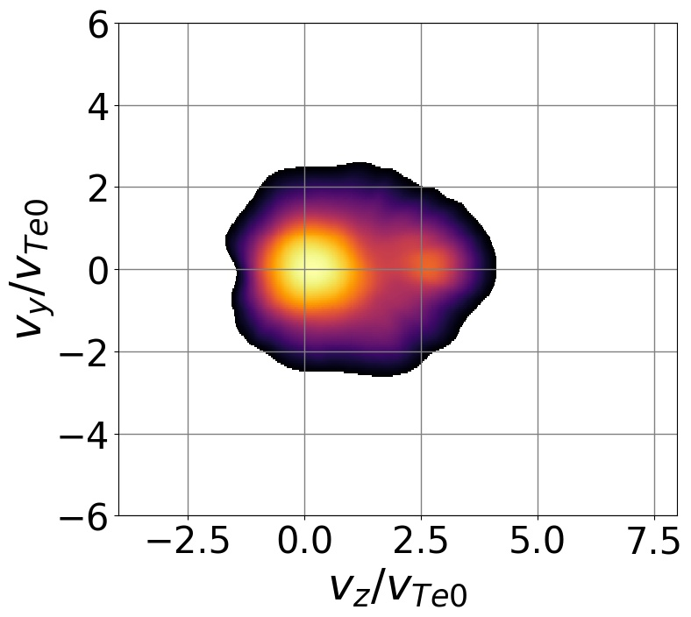
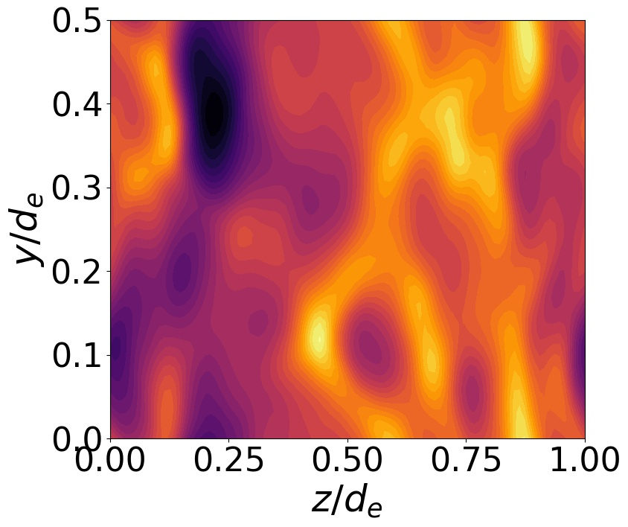
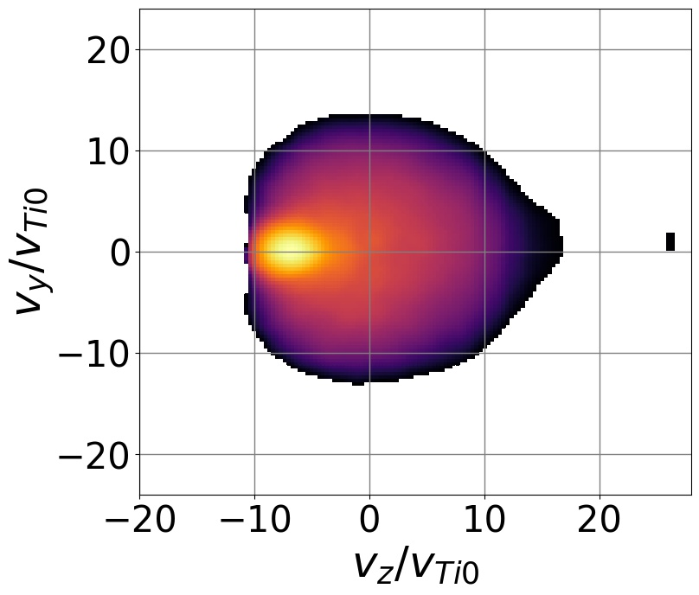
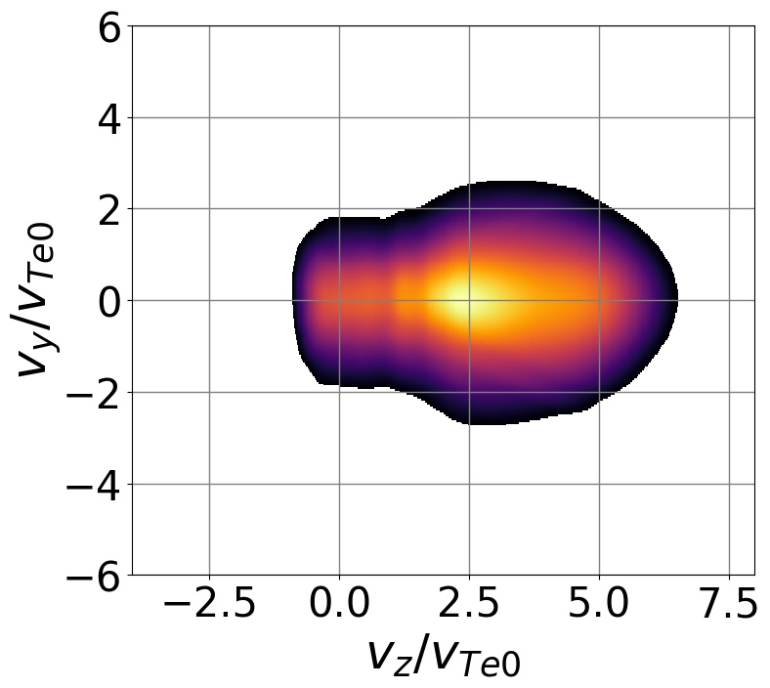
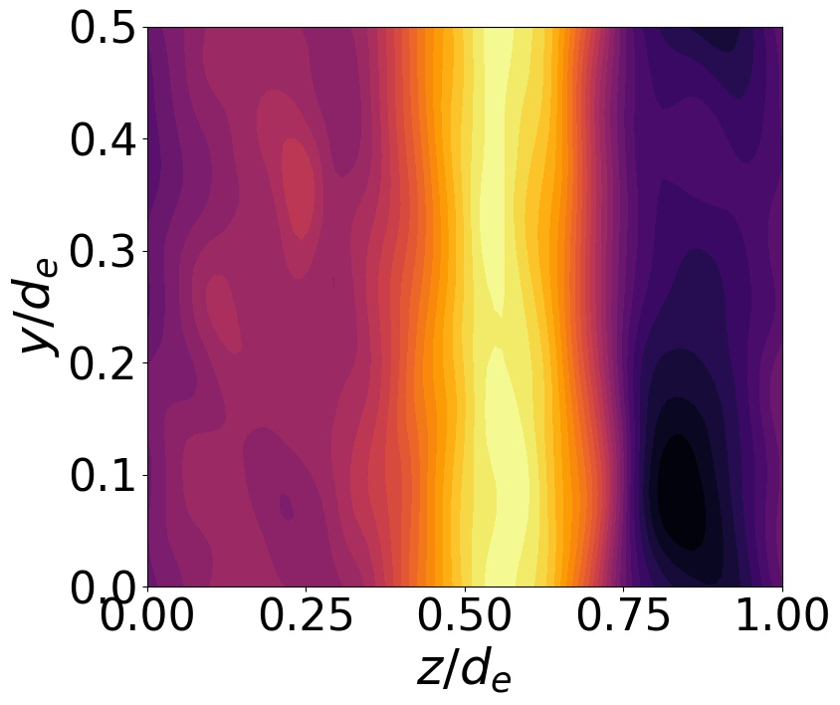
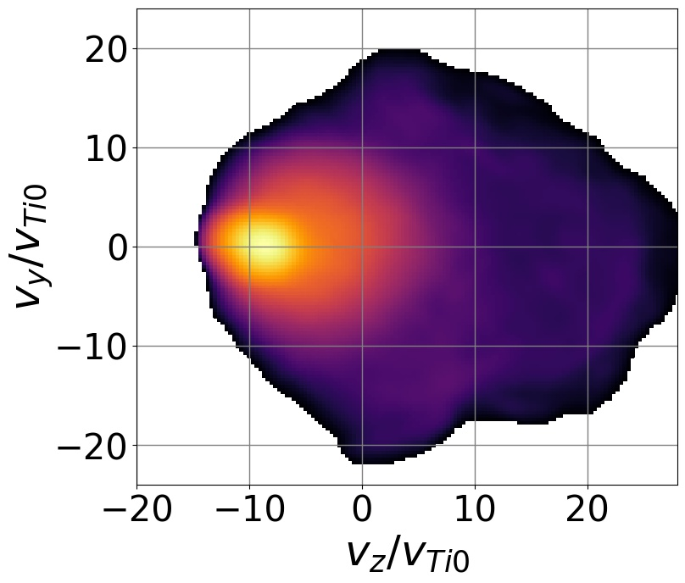
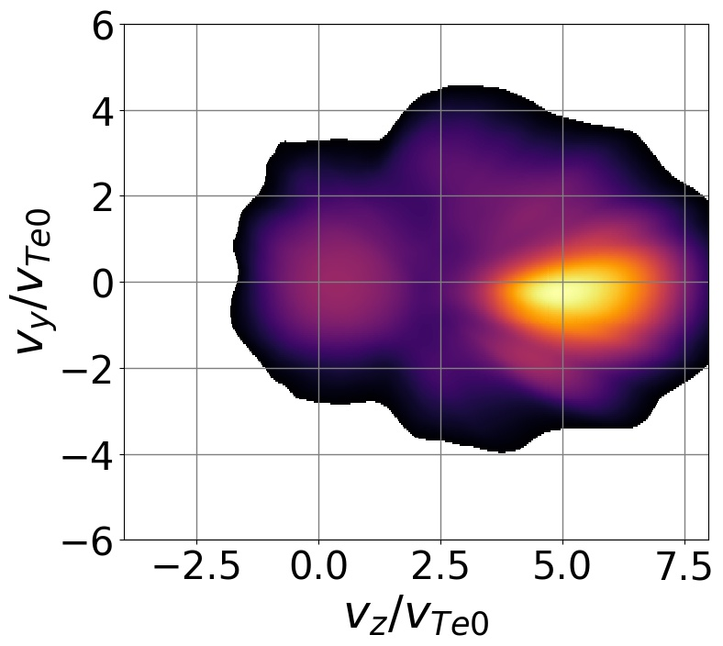
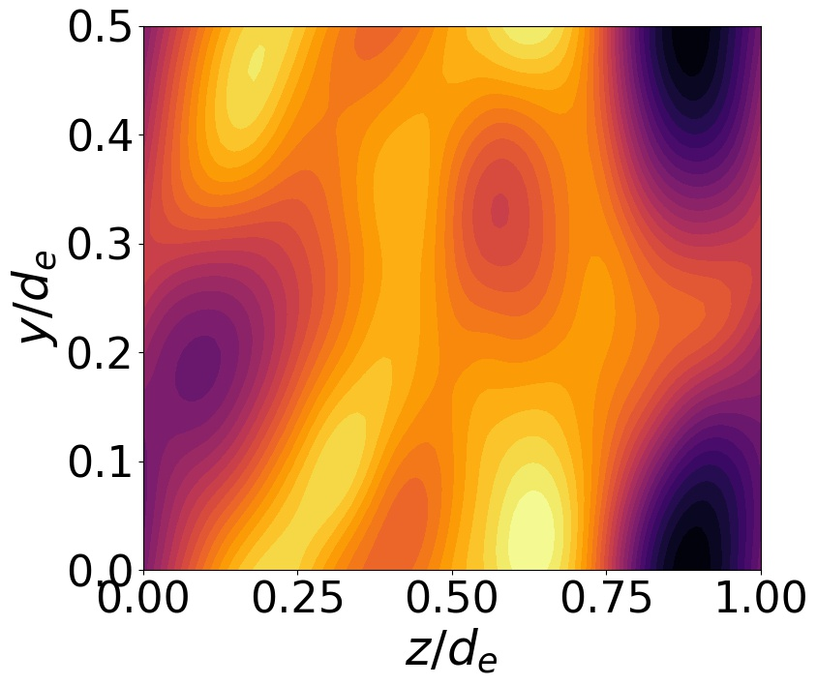


${log (f}_{i}\left(z,v_{z}\right))$ $f_{e}\left(v_{z},v_{y}\right)$ $f_{e}\left(z,v_{z}\right)$ $φ(z,y)$
$$ω_{pe}t =750$$
$$ω_{pe}t = 1800$$
$$ω_{pe}t =2400$$

